Slide 1
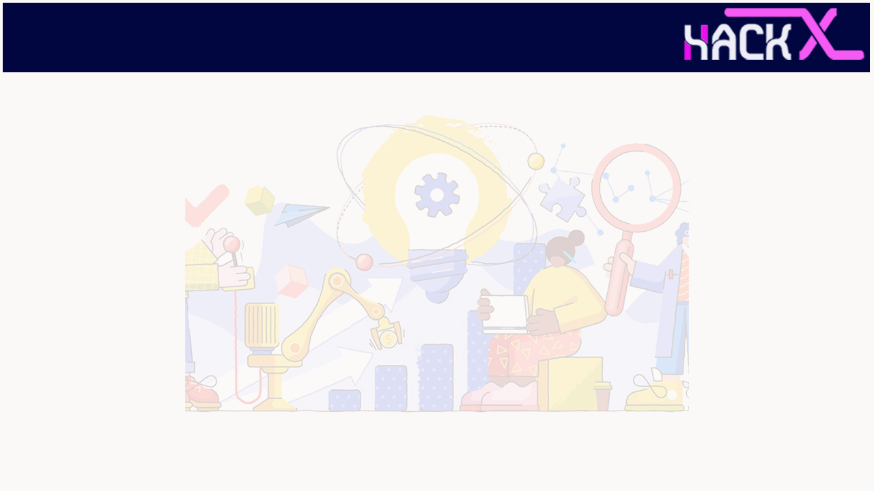
TEAM DETAILS
The Techies
Shubh Mittal (Team Leader) - +91 80049 23260 Aman Agarwal – +91 99849 24039
Sai Harsha Varma - +91 90499 17706
Open Innovation
Waste management is a one of the hard problems. The existing model is very ineffective due to its poor placement, collection scheduling, dump yard allocation and management, ever increasing transport cost and resulting health issues.
Website Link: https://shubhmittal44.github.io/HackX_Project/login/homepage.html

Slide 2
ABSTRACT
An interactive website that will connect vendors, customers, and recyclers through a Graphical User Interface which will help in improving waste management, recycling more products thereby reducing pollution and also increasing employment opportunities.
The website will be divided into three sections wherein the first section will be for the customers who want to sell their recyclable waste, the other section will be for the vendors who will collect that waste at a defined price (depending on the location) and the third section will be for the recyclers who will collect the waste from the raddiwalas of that particular region and will also sell the recycled products on the site itself!
The website will assign vendors similar to the way Zomato / Uber Works.
Therefore it will serve as a win-win situation for all connected with the website making profits and money through the website itself.
The charges and rates will be altered on a daily/weekly basis by coordinating with the vendors in different regions, surge charges will be applied on the regions which have less connectivity/ availability of vendors, also there will be a section for articles generating public awareness regarding waste management.

Slide 3
NOVELTY
India has a significant unorganised sector consisting of highly localised small scale “kabbadiwalas” or “raddiwalas” as they are popularly known. They are scrap dealers who buy domestic scrap and junk, such as old newspapers, discarded electronic and metallic items by weight from the homes of people.
The way it works in most parts of the country is that a raddiwala goes around from place to place calling for people willing to sell their scrap and recyclable waste and are thus dependent on whether the person who is willing to sell hears their call.
This is a highly inefficient process for everyone involved. The raddiwalas have to spend a lot of time and energy finding potential customers, and for people having scrap at their homes many times it simply becomes easier to dump it in the trash rather than waiting for a kabbadiwala to come by and buy it from them. This is a rampant problem and ultimately leads to a lot of potentially recyclable material being sent to dumping grounds instead of being collected, recycled and reused.
Our product, raddiwala.com intends to solve this by being a platform that bridges the gap between the raddiwalas and the people with domestic scrap at their homes connecting them for their benefit.

Slide 4
NOVELTY
Whenever someone wants to sell their scrap, they can easily book a scrap dealer, aka raddiwala registered with our platform to come to their place at a convenient time, along with a fixed rate chart so that they know exactly how much money to expect. Consequently, scrap dealers close to the location of the seller would be notified, and the first person to accept it gets the contract.
In addition to being extremely convenient, our product also solves an equally pertinent issue : centralising, standardising, and bringing under one roof the significantly decentralised and disorganised sector of raddiwalas.
We would be providing all our registered raddiwalas with standardised electronic weighing equipment, modern and sturdy equipment for transporting the scrap, clean uniforms, and so on.
Along with that, there would be a uniform, transparent and well defined rate chart for every type of domestic scrap.
We believe that technology has the capability to make lives simpler and contribute positively to our society and with the same spirit, our product aspires to contribute to the goal of making our planet greener and promote recycling and reusing.

Slide 5






TECHNOLOGY STACK
HTML
CSS
JavaScript
Django
PostgreSQL
Machine Learning

Slide 6
SOFTWARE IMPLEMENTATION
HTML – Framework of the website
CSS/Bootstrap – Structure and design of the website
JavaScript – To make the website interactive
Django – To connect Front-end and the Database
PostgreSQL – To store Raddiwala bookings and customer queries
Machine Learning – For Chatbot

Slide 7
BUSINESS SCOPE
Marketing Strategies
The marketing strategy for our company will be divided into four sub sections one
social media
search engines
videos and blogs
email sequencing
Everything will be search engine optimized and further clarity will be given to the users using different virtual personas. Also, there will be a review/ rating system for all the three different kinds of users.
Our marketing program will focus on increasing its visibility in the community. Award plaques will be distributed to stores each year and the program will find additional methods to raise the profile of stores that assist the program.
Our program will focus on establishing an effective collection network with local growers, retailers, wholesalers, and processors. Another primary goal will be the creation of a youth farm that will employ “at risk” youth. The program will also start a fundraising campaign with area retail markets, banks and credit unions .
Helping Hand will advertise its services to the target populations groups through the agencies that serve these groups on a daily basis.

Slide 8
BUSINESS SCOPE
Financial Model
CUSTOMER SEGMENTATION
COST STRUCTURE
REVENUE GENERATION
Demographics : All ages and gender
Psychographics : Eco-friendly
Needs : Environmentally responsible, monetary
AdSense
Commissions from recyclers
Premium subscriptions
Surge Charges
Collaboration with different companies
30%=Marketing
40%=Transportation and operational
10%=Technology and Design
20%=Miscellaneous
Future Vision
We cannot stop waste production entirely, but everyone can make a significant contribution.
Our product helps in saving energy and natural resources, helps to reduce pollution and reduces the need for landfill.
The coming world is a digital world. The online platform made by us will be easy to use for everyone . Also, the waste in this world is increasing day by day and the need to control waste is very important. We believe that our website will prove crucial in waste management .

